Slide 1
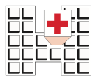

“Sacro Cuore - Don Calabria” Hospital, Negrar, Verona, Italy,
ACT – EAT brief intervention based on Acceptance and Commitment Therapy for weight loss in cancer patients
Giuseppe Deledda¹, Chiara Anselmi², Federica Maccadanza¹,
Angela Di Canio¹, Stefania Gori³
  Service Clinical Psychology
  Department of Medicine Clinical Nutrition and Dietetics
  U.O. Oncology,
giuseppe.deledda@sacrocuore.it
Symposium : ACT in Health Psychology
ACBS’s World Conference X in Washington, D.C,
June 22, 2014

Slide 2
Background
“Cancer is a major life-threatening disease that can evoke deep-rooted fear of death and sense of loss of hope. Even the word, cancer, has powerful connotations of anxiety, pain and suffering.”
(Al-Amri; Eastern Mediterranean Health Journal, 2009;15:1)
The diagnosis and treatment are stressful events and the patient needs to adapt to a situation for a long period of time.

Slide 3
Background
In the context of breast surgery and chemotherapy-associated alopecia, weight gain further affects self-image, is a frequent patient complaint and impacts on quality of life
(Makari-Judson et al, The Breast Journal, 2007;3: 258–265)
The weight gain affect 50-96% of breast cancer patients (Rooney & Wald, 2007).

Slide 4
Background
The Acceptance and Commitment Therapy (ACT) (Hayes, 1999), has shown good results to weight loose and maintenance phase
(Forman et al, 2009; 2007).

Slide 5
Aims of the study
The aim of this study is to evaluate the feasibility of a multidisciplinary group intervention promoting a healthy lifestyle based on ACT for cancer patients

Slide 6
Design and Methods
The feasibility of the intervention was evaluated using:
the percentage of drop-outs
the impact of the intervention on the lifestyles adopted by patients (healthy eating habits, a moderate low-calorie diet, and the making of physical activity of moderate intensity).

Slide 7
Design and Methods
a set of four-monthly sessions
follow up after 3 and 6 months
The sample had two different aims (loss/increase weight) and was divided into three groups, depending on the patients’ starting BMI
G1: BMI<21,9
G2: 22<BMI<29,9
G3: BMI<30)

Slide 8
Design and Methods
Pre e Post intervention measures:
socio demographic
TFE.Q 51 (Three-Factor Eating Questionnaire 51): (Stunkard e Messik,1985)
Termometro dello Stress (Jacobsen et al, 2005; Gil et al, 2005)
BIAAQ2 (Body Image–Acceptance and Action Questionnaire” (BI-AAQ) (Sandoz,Wilson &Merwin, 2009)
AAQ-2 (Acceptance and Action Questionnaire II) (Hayes et al, 2004)
Bull’s Eyes (Dahl J. & Lungreen T., 2005)
PWBQ (Psychological Well Being Questionnaire) (Ryff, 1989; Ruini et al, 2003).
RSCL -Rotterdam Symptom Checklist (de Haes et al., 1990, Paci et al, 1999)

Slide 9
Instruments
ACT-EAT GROUP INTERVENTION
Flow Chart
Informed consent
Sociodemographic and clinical variable
Cancer patients
Recruitment in U.O. of Oncology
Weight and height detection
Questionnaire:
Distress Thermometer: meseaure the emotional distress and problems related to it (practical, relational, emotional and physical) (Jacobsen et al, 2005; Gil et al, 2005)
Three Factor Eating Questionnaire-51 (TFE.Q 51): assess the cognitive aspects (51 item) of control and lack of control on nutrition, and susceptibility to hunger (Messik & Stunkard, 1985);
Acceptance and Action Questionnaire II (AAQ-2): investigate the construct of psychological flexibility (9 items) measuring avoidance of emotions and the degree of acceptance of own inner experience (Hayes et al, 2004);
Bull's-eye: investigate the subject's ability to recognize the values in four area (Work/study, Leisure, Personal Growth/Health, Relationships). The values assume the role of positive reinforcement that favor the maintenance involved in the short and long term behavior of the functional (effective) for the person (Dahl & Lungreen, 2005).
Rotterdam Symptom Checklist (RSCL): meseaure (38 item), physical and psychological symptoms, function in daily activities and quality of life (de Haes et al., 1990, Paci et al, 1999).
Psychological Well Being Questionnaire (PWBQ): measure (18 items) autonomy, control environment, personal growth, positive relations with others, purpose in life, self-acceptance (Ryff, 1989);
Food Diary
Diary of Physical Activity
Satisfaction with the encounter (Likert scale)
Screening
Inclusion Criteria
Exlusion Criteria
Patient asked for informed consent
n eligible patients = 24
Base Line measures
First encounter
And
Outcome measures
Fourth encounter
Process mesures
Four monthly encounters
And
Two Follow Up
(at 3 and 6 mounth)
Patient’ reported Weight
Food Diary
Diary of Physical Activity
Satisfaction with the encounter
Bull's-eye

Slide 10

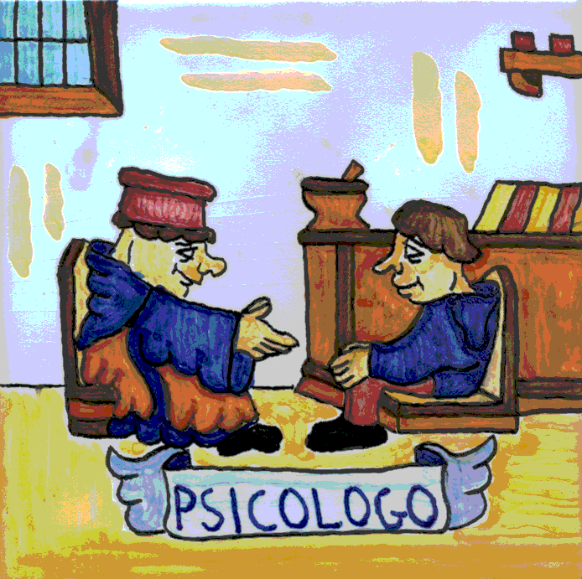


Design and Methods
The participants
Psychologist
Nutritionist
Oncologist
Patients

Slide 11

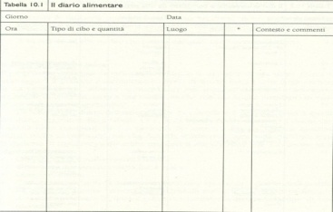
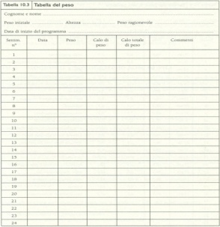
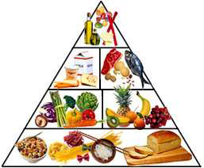

Methods
Nutritional and Behavioral Components
Analysis of patients’ expectations and motivation
Presentation of objectives
Introduce: Importance of self-monitoring of caloric intake
Introduce/homework: “Food Diary” (FD) and
“Diary of Physical Activity” (DPA)
Introduce: Nutritional information, education and guidelines:
Role of fat
Carbohydrates and sugars
Food guide pyramid
Introduce: Meal planning
Introduce: Nutritional information, education and guidelines:
Portion sizes and portion control
Behavioral strategies for caloric adherence
Introduce: Guidelines for physical activity
Barriers and benefits of physical activity

Slide 12


Slide 13



Methods
ACT Components
Introduce: Limitations of experiential control
Help patient let go of the control
What obesity costs?
Introduce: Suffering as normal human experience
Introduce: Finding hope: looking kindly at your strugle
Sitting With Suffering
Acceptance as an alternative to control strategies
specifically relating to adhering to caloric intake
and physical activity recommendations
Introduce: Willingness

Slide 14


Methods
ACT Components
Introduce: Value and Committed action
Choose actively in the present moment
Relinquish
solid ground
&
confide

Slide 15
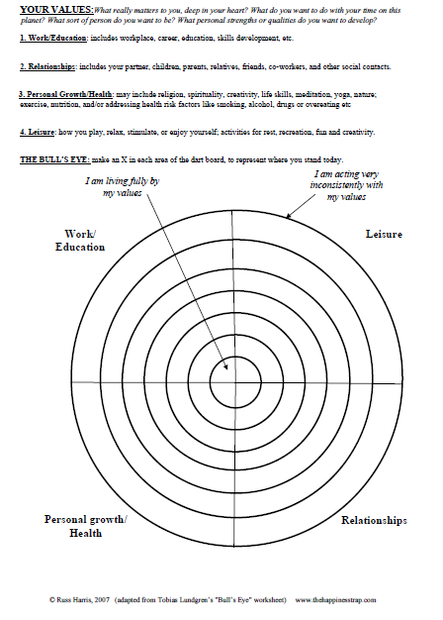
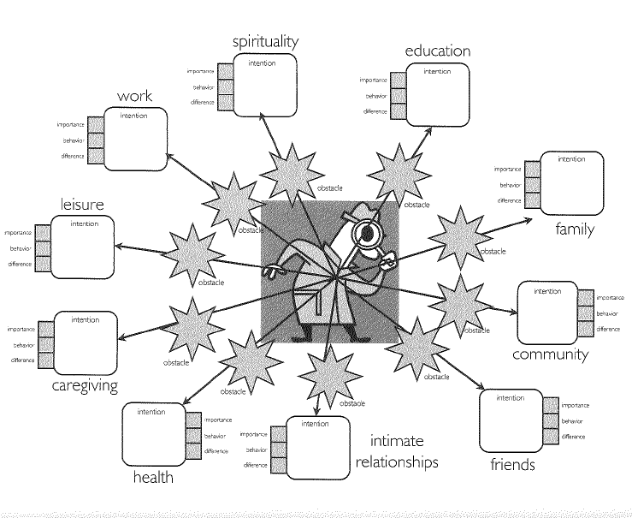
Methods
ACT Components
Introduce: Value and Committed action
Dahl et al. 2009

Slide 16

Methods
ACT Components
Introduce: Distinction between values and goals
Goals
Eating more fruits and vetables

Slide 17


Methods
ACT Components
Introduce: Strategies to reduce mindless eating
Review: Limitations of experiential control
Review: Acceptance as an alternative to control
Introduce: Mindless vs. Mindful eating
The raisins exercise…
eat in the present..

Slide 18



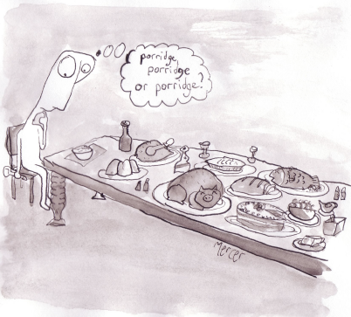

Methods
ACT Components
Introduce: Values clarification
specifically discussing how this can enhance commitment
Introduce: Importance of workability
Introduce: Defusion vs. fusion
Introduce: Urge Surfing

Slide 19

Methods: Section 4
The Passengers on the Bus
Metaphor

Slide 21
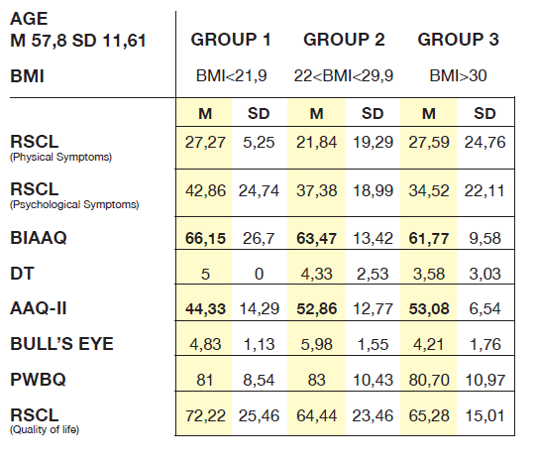
Results
Weight
<6,8%
Weight
<3,4%
baseline data

Slide 22

Conclusion
These preliminary data show that patients collaborated actively, despite high initial levels of psychological and physical distress, adhered to the encounters, completed the intervention tasks.

Slide 23
Conclusion
The data show a greater weight loss by patients with BMI < 30.
Consistent with the data in the literature, patients with BMI greater than 30 have shown difficulties linked to the obesity problem including lower acceptance of their body image, difficulty of management of eating behaviour, and then a more difficulty of weight loss.
For the effectiveness of an intervention focused on healthy lifestyles and weight loss is important to consider the psychological variables and in particular the starting BMI.

Slide 24
Future directions
This was also a preliminary study for a following clinical trial which intends to evaluate the effects of the intervention group on patients acceptance and the effect on the weight

Slide 25
“Sacro Cuore - Don Calabria” Hospital, Negrar, Verona, Italy,
The Acceptance and Commitment Therapy for increase the psychological flexibility of cancer patients in palliative care
Giuseppe Deledda
  Service Clinical Psychology
giuseppe.deledda@sacrocuore.it
Symposium : ACT in Health Psychology
ACBS’s World Conference X in Washington, D.C,
June 22, 2014

Slide 26
Existential condition of the person suffering from a terminal cancer pathology is complex
Rapid changes and pain can slide into a deep despair and can lose hope

Slide 27
In patients requiring specialist palliative care, rehabilitation traditionally aims to improve patients’ physical functioning by addressing social, psychological, or spiritual problems that may affect a patient’s quality of life and of symptom control

Slide 28
Rehabilitation may be compromised by the intrusion of negative thoughts or feelings, for which it appropriate to support these patients in order to develop strategies to manage these issues more effectively
(Low et al, 2012).

Slide 29
In recent studies it has been recognized the importance of the model based on Acceptance and Commitment Therapy with palliative care patients
(Fegg , 2005; Andrew & Dulin, 2007; Ciarrochi, Fisher & Lane, 2010; Karekl & Constantinou, 2010; Low et al, 2012; Joleen Carol Sussman & William Ming Liu, 2013).

Slide 30
ACT is sensitive to a person's belief system and this allows for an encouraging environment where the client can openly discuss his or her religious and spiritual beliefs and how they utilize these beliefs in everyday life, to subsequently help the person accept any experience that the person has no control over in light of these values, and to then commit and take actions consistent with these values
(Karekla Maria, Constantinou, 2010).

Slide 31
In the therapeutic process ACT, a variety of metaphors, are employed to initiate an experientially oriented therapeutic process.
(Sonntag, 2005; Hayes et al., 2004)

Slide 32
“Creative Hopelessness”
Is Starting point for a new beginning, in order to promote awareness and motivate to a life richer and more meaningful
the control of struggles is unsuccessful

Slide 33
Self as context
Subsequently, the focus of the sessions is brought on self-awareness, distinguishing the “observing self” from the “conceptualized self”
“I am a person who…”
as Hayes said “the “I” that is referred to is not just a physical organism, it is also a locus, place, or perspective”
(Hayes et al., 2004).

Slide 34
Defusion
Getting distance from your thoughts
Explore your rules about pain
«Feeling pain is unacceptable… I can’t live a good life…»
«There are so many bad people in the world …yet still I am punished with this»

Slide 35
Mindfulness
Belly Brething
Body Scan
Eating Minfully
Sleeping Mindfulness

Slide 36
Valuing
The difference between Reasons and Choice:
«I choice to be an angaged mother»
Value as chosen life direction
(Hayes et al, 1999)
Exploring the life domains
Intimate relationships Family relationship
Social relationship Parenting
Work …..

Slide 37
Moving on to a valued life
Committed Action
Just go out and do it
Step – by –step
Live in accord with your values every day
It is possible !!!!

Slide 38

Thank you for your attention!
Grazie per la vostra attenzione!

